Slide 1
A Mini-Project Report
On
“Prediction of Taxable Amount(Gross Amount)”
Domain:Finance
Piyush Datir-1132200500
Aditya Joshi-1132200230
Aniket Pawar-1132200111
Aditya Dorwekar-1132200246

Slide 2
Motivation and Application
Having future insights into the sales and purchase data using predictive analytics can give a better result for any organization. It will minimize the losses and maximize profitability. Lack of future planning may result in huge losses in the business.
Application:
The use of this system is to have a better understanding of the sales and purchase data, through which an organization or a company could monitor profits and losses.

Slide 3

Literature Survey:
For the project, we went through various research papers, which gave us insights & approaches about the working of the model. The literature survey is done by visiting websites and research papers published on somewhat similar topics.
Michael Schaidnagel, Christian Abele, Fritz Lauxy, Ilia Petrovy Sales Prediction with Parametrized Time Series Analysis—In This paper they have used timeseries & ARIMA (AutoRegressive Integrated Moving Average). We also tried the timeseries and ARIMA in our solution.
MOHAMMAD ZOYNUL ABEDIN 1, GUOTAI CHI 2, MOHAMMED MOHI UDDIN3, MD. SHAHRIARE SATU4, MD. IMRAN KHAN5, AND PETR HAJEK 6 Tax Default Prediction Using Feature Transformation-Based Machine Learning-in this paper the model which is used is XGboost.
Purvika Bajaj1, Renesa Ray2, Shivani Shedge3, Shravani Vidhate4, Prof. Dr. Nikhilkumar SALES PREDICTION USING MACHINE LEARNING ALGORITHMS .This paper was published by the students of MIT ADT university. In this paper there were detailed information about all the models like Linear Regression, k-nearest neighbours, XGBoost Regressor, Random Forest Regressor.

Slide 4
Domain:
The domain on which we are working is a finance domain. The problem statement is to predict the taxable amount based on manufacturing cost and export type.
The Data we have gathered…
There were a total about 2400 records in our dataset and 27 to 28 columns at beginning
Dataset Used:

Slide 5
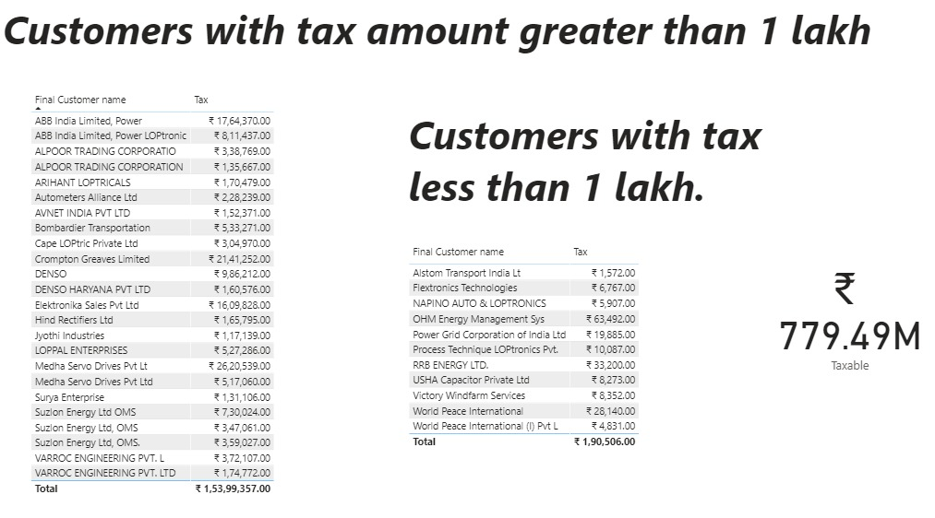
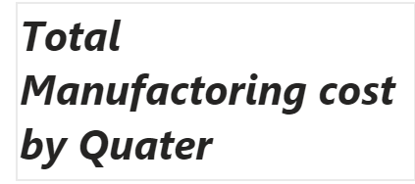
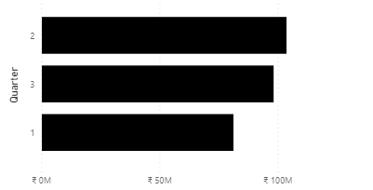
Sales data:

Slide 6
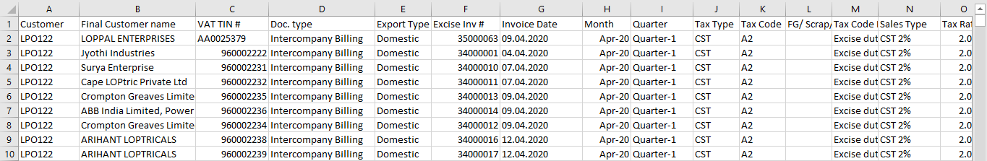
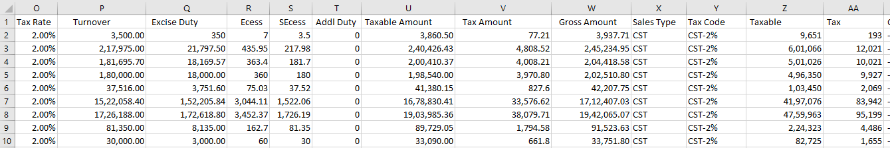
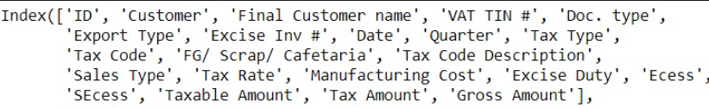
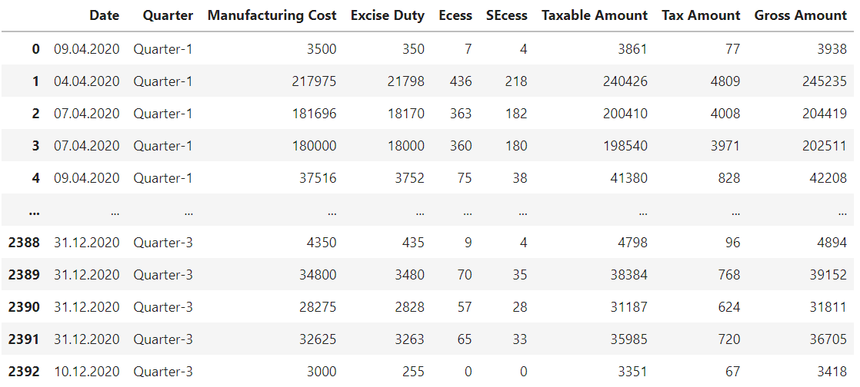
Dataset
Features
Considering the Significant Features

Slide 7
SOLUTION APPROACH
We began with data collection. We got the dataset from a CA firm, then we started the EDA and pre-processing part. Further, we have used pandas profiling for the EDA and also an Automated library for Visualisation. As our data is authentic it showed a huge correlation between the Features. Moving on to the further pre-processing we separated our features and label attributes. Then we split the dataset into training and testing. Then we tried our first algorithm i.e., Lazy predict Regressor. As our Data is Authentic the Lazy Predict Regressor gave the accuracy up to 99%. So we continued our prediction on the linear regression by building various models to get the best model.

Slide 8
Future Work:
TECHNOLOGY STACK:
Programming language: Python
Library: Stats models, Numpy, Matplotlib, pandas, pandas profiling, sklearn.
Algorithms: Lazy Predict Regressor, Linear Regression, KNN, Decision Tree.
We are planning to make detailed model on this problem statement.
Deploying model on the cloud platforms such as Flask and Heroku.
Finding some factors which effect the Taxable Amount using ANN approach.

Slide 9
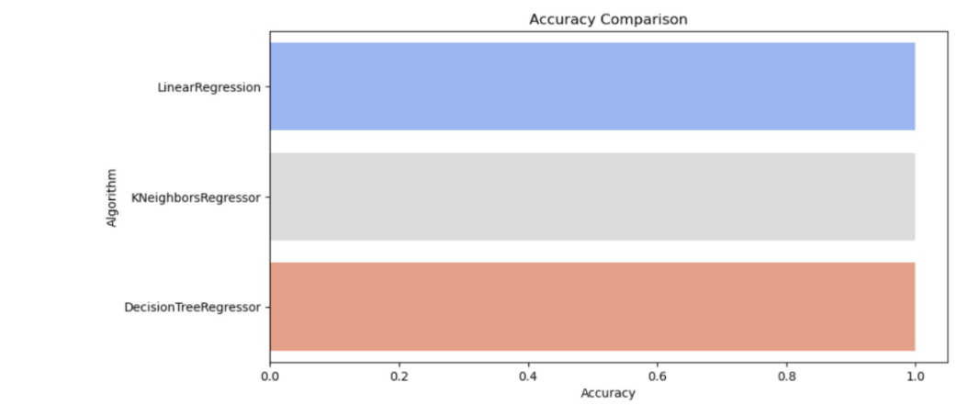
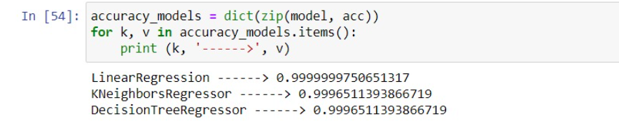
Model Evaluation

Slide 10
Thank You

